Slide 1

Twitch Platform
Data Analysis
Notes:
Title Slide
Members
Define the core message or hypothesis of project
Is Fortnite the best game to stream?
It depends on how the new twitch streamer wants to go with
Fornite is great to bounce ideas from other streamers and have an idea of what to expect
If you wanna be a company who is launching a game we can hire a person etc..
If you are a game developer how can twitch help your business? why is this important for you in this day and age
If you are a broadcaster or content creator, how can you use twitch to your advantage?
LIMITATIONS
No access to demographics or financial data
No access to historical data
Collecting data for less than a week
No long term trend analysis
Not having a dedicated server to execute the file every hour
If we worked at a gaming company we would have gathered even better data
Mention why we decided to pull hourly data
As as company you might want to partner with a streamer. Choose somebody who fits your company's culture and truly represent the image you are trying to pass. Companies can launch products and have their favorite streamer introduce and even drive the product to help boost the companies results in sales.
CONCLUSION
If we had more time this data could be explored to analyze further -
How to maintain an audience.

Slide 2


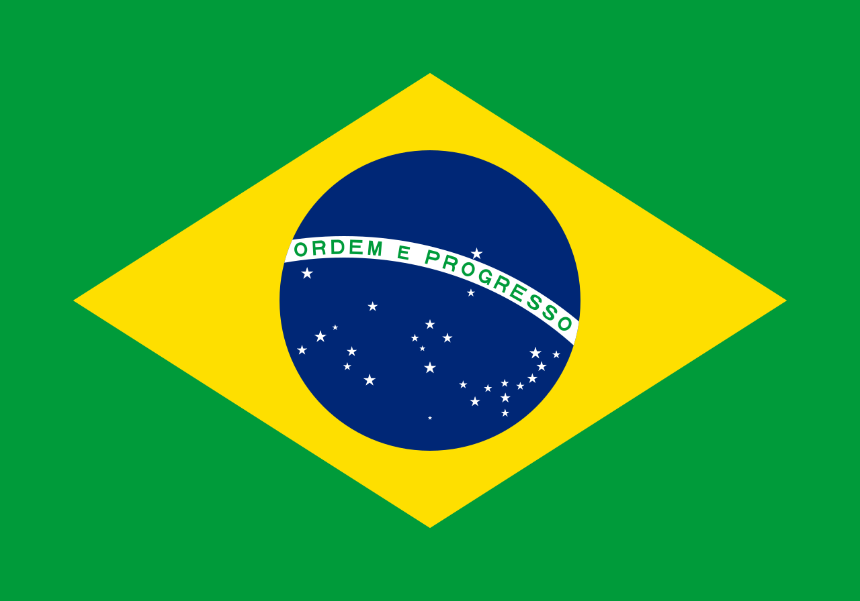


\ About Us
HI !
5 millennials
from 5 different cities and over 4 different countries and 25 years of experience (in living).
With cultures from
New Orleans, USA
Montreal, Canada
São Paulo, Brazil
Hyderabad, India Cali, Colombia
Matthew Cole
Romy Robillard
Lucas Santos
Meghana Bhimasani
Andres Gomez
Notes:
We explored the Twitch Platform in order to gather, analyze, and help businesses make their best decisions for 2019.

Slide 3
Twitch Facts
- Live streaming video platform
- Subsidiary of Amazon
- Founded in 2006, officially launched in 2011
- No. 1 website traffic rank in gaming category
- Avg. visit duration: 00:06:21
- 862.28 M total visits
Notes:
For those who dont know.. Twitch is….

Slide 4
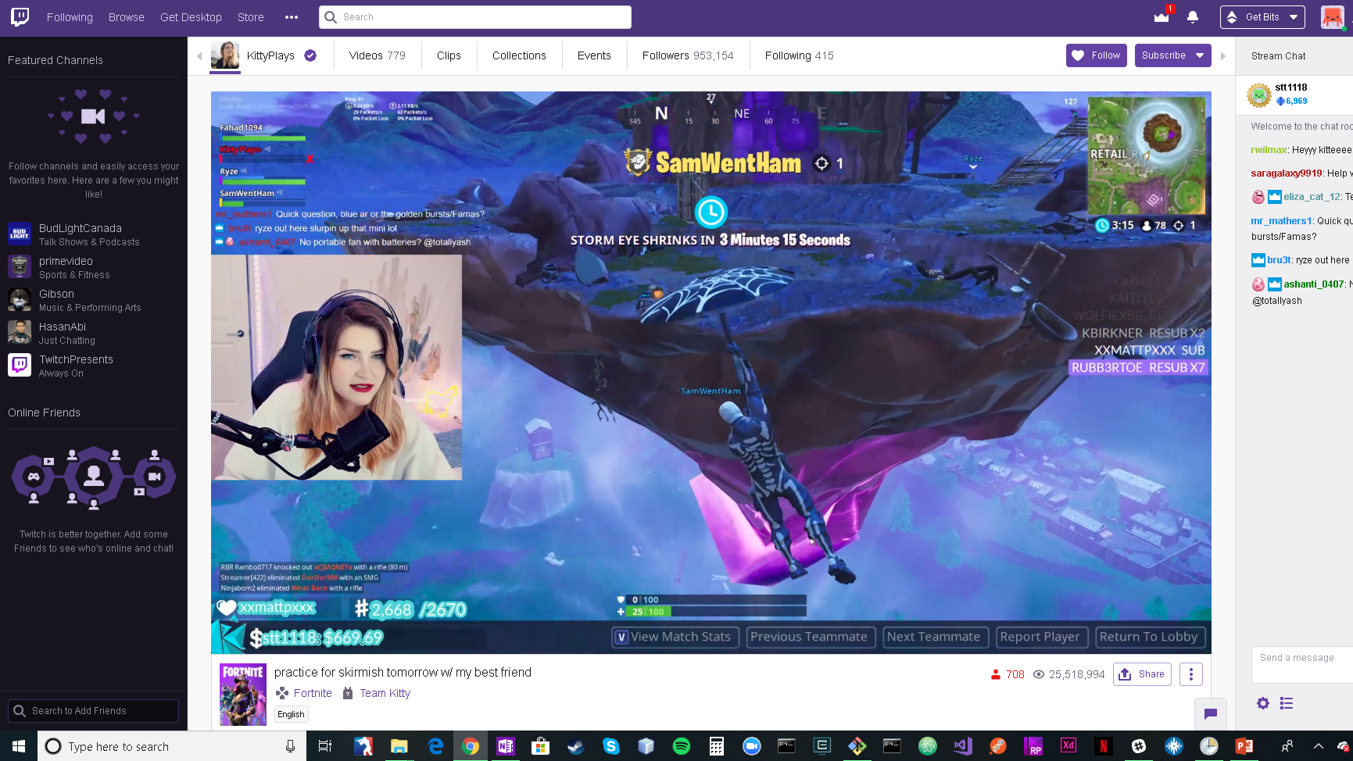
What it looks like

Slide 5
Exploratory Research Questions
As a game developer in 2019, how can Twitch help your business and increase exposure?
If you are a broadcaster or content creator, how can you use Twitch to grow your personal brand?
Notes:
First question: i.e. how can companies capitalize on the fact that twitch has created a new phenomenon where people are not only playing their games but are also watching others play their games?

Slide 6
TOOLS UTILIZED
\
\
Git Bash Commands
GAMING PLATFORM
GitHub
\
\
ANALYTICS
Data Visualization
Python / NumPy / JSON / Pandas
Notes:
Lets take a step back and understand a bit of our process and tools we utilized to unfold this story
We used a lot of the git bash commands
Obviously went in depth with the Twitch Gaming Platform

Slide 7




\ End-To-End Process
JSON Requests Using Twitch API
Structurize/ Manipulate Data via Pandas
Export to CSV Hourly & Merge
Sense Making
Visually Represent
Notes:
To answer these questions we used the following steps:

Slide 8
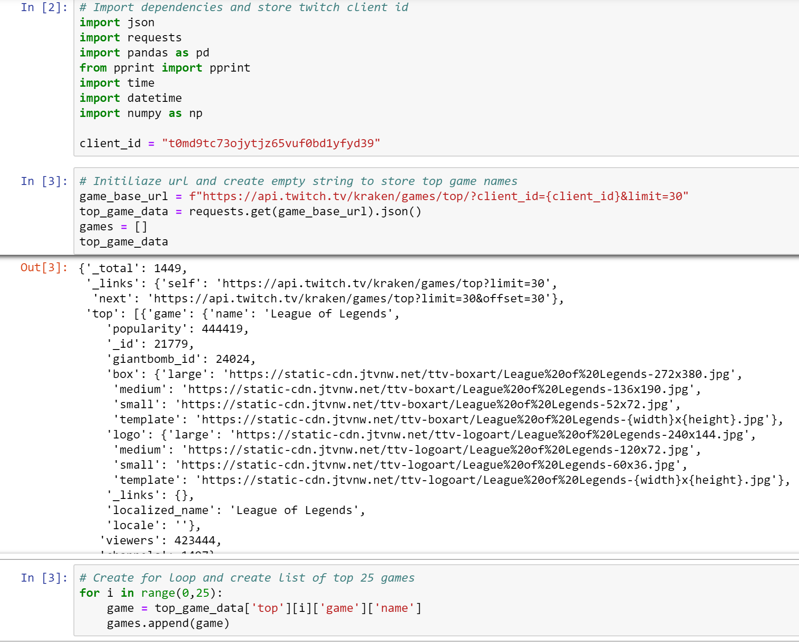
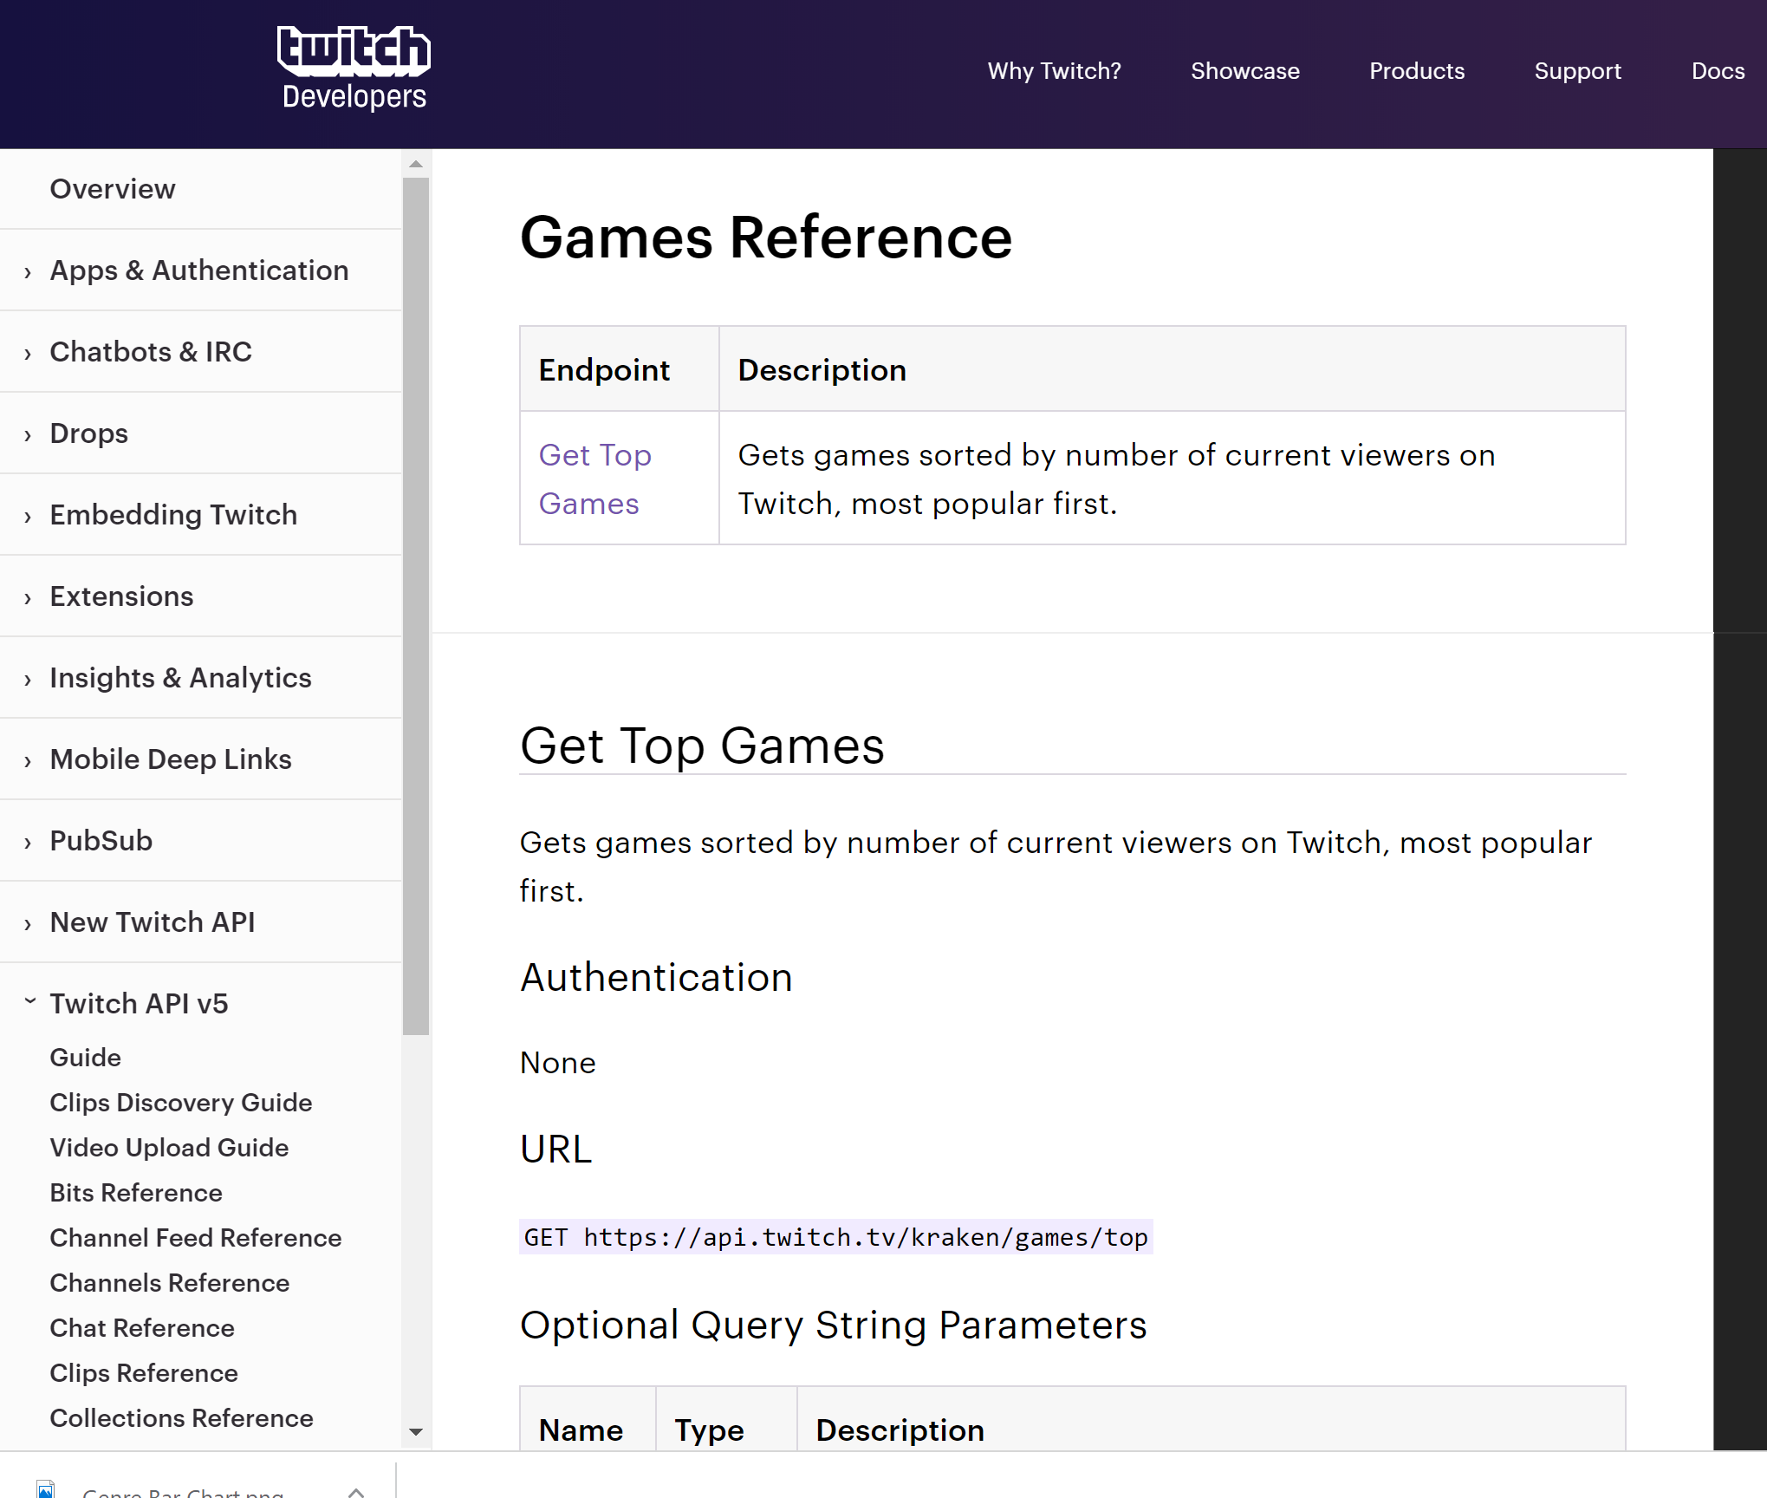
\ JSON requests Using Twitch API
Pull Data using Twitch API
Notes:
In our mission to create an accurate story to at least attempt to answer these questions, we used as much data from the twitch API as was available to us. In doing so, we realized historical data would be of great importance in order to accurately depict trends. Therefore, we decided to do write code that would run once an hour for as long as possible (which ended up being around a week). The hourly requests were made to 2 real-time endpoints: Get Top Games and Streams Data, which was dependent on the previous request. The JSON formatted data that was returned to us provided us with useful information such as current viewers, etc.
Focus on:
We thought it was a good idea to first look into the top 25 games and the top 10 streamers per game and because there is no historical data available, we did an hourly pull using the twitch API to track the trends.
Because there was no historical data we had to ….
What we were able to get from the API
Limitations
No access to demographics or financial data
No access to historical data

Slide 9
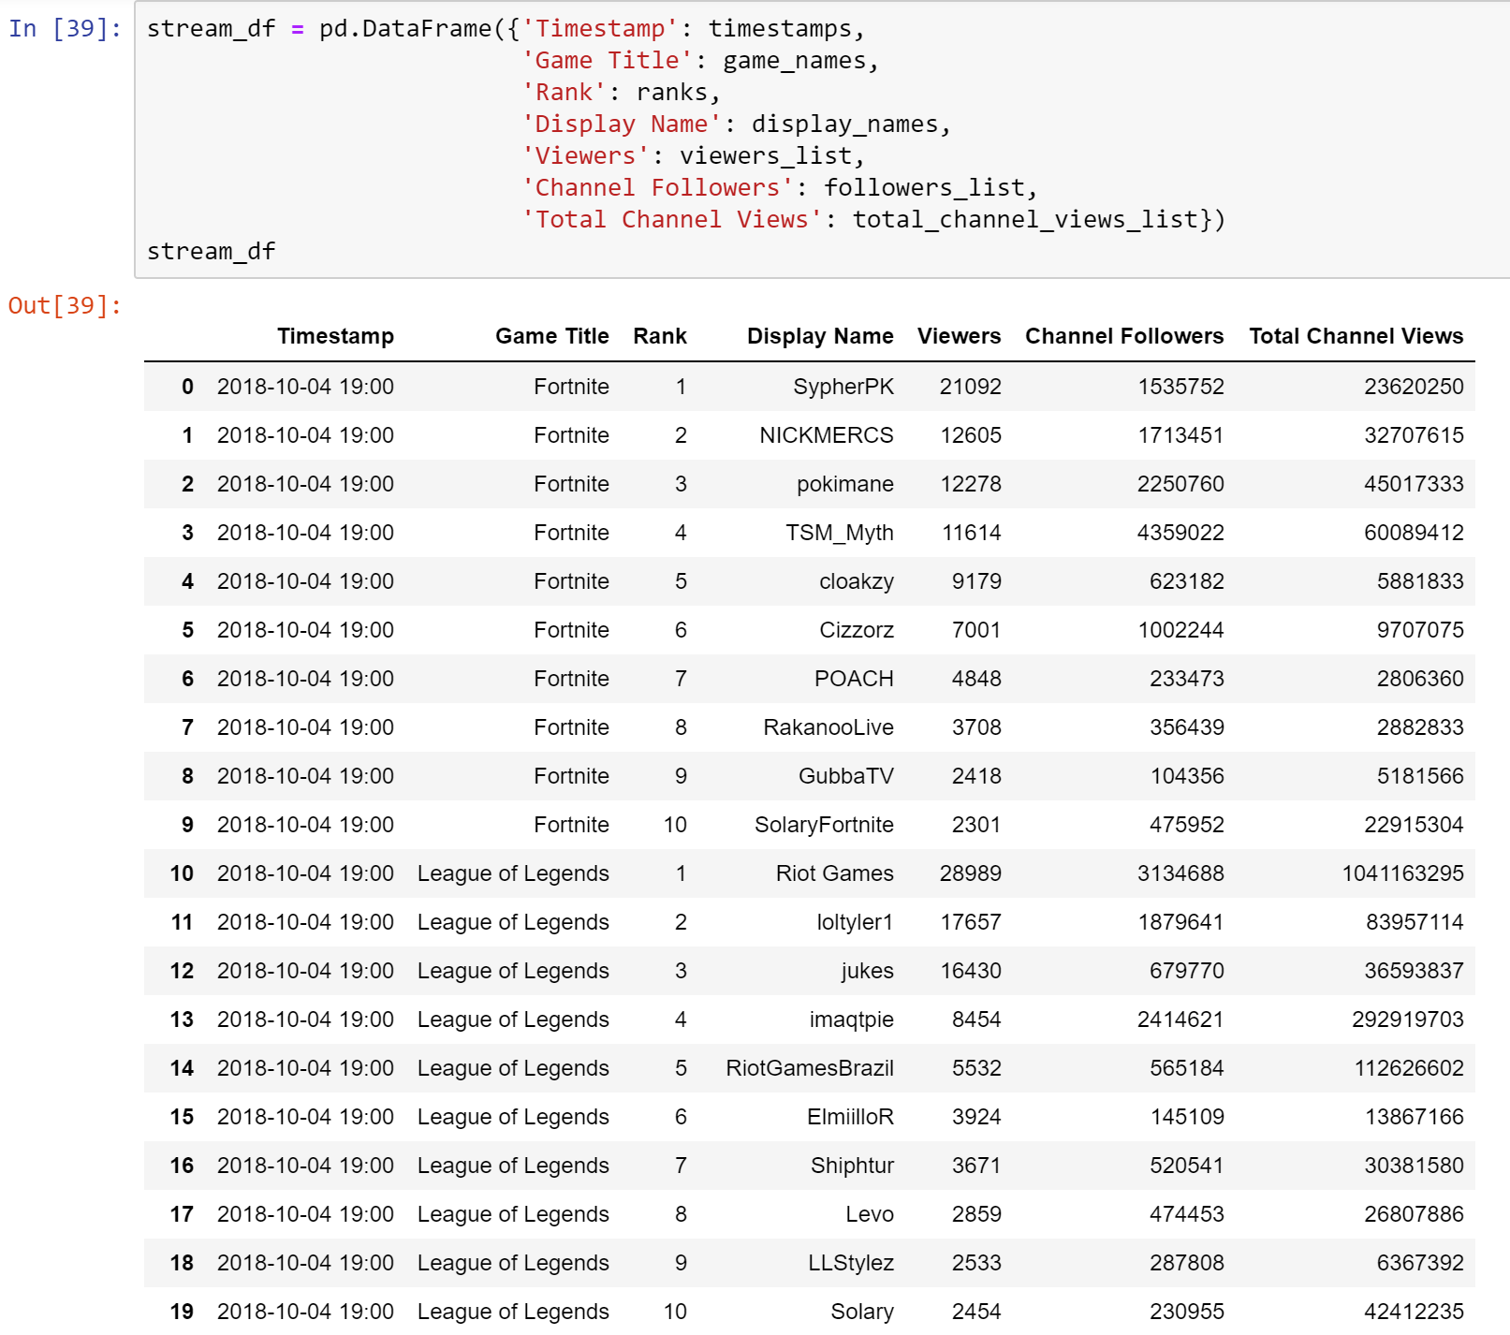
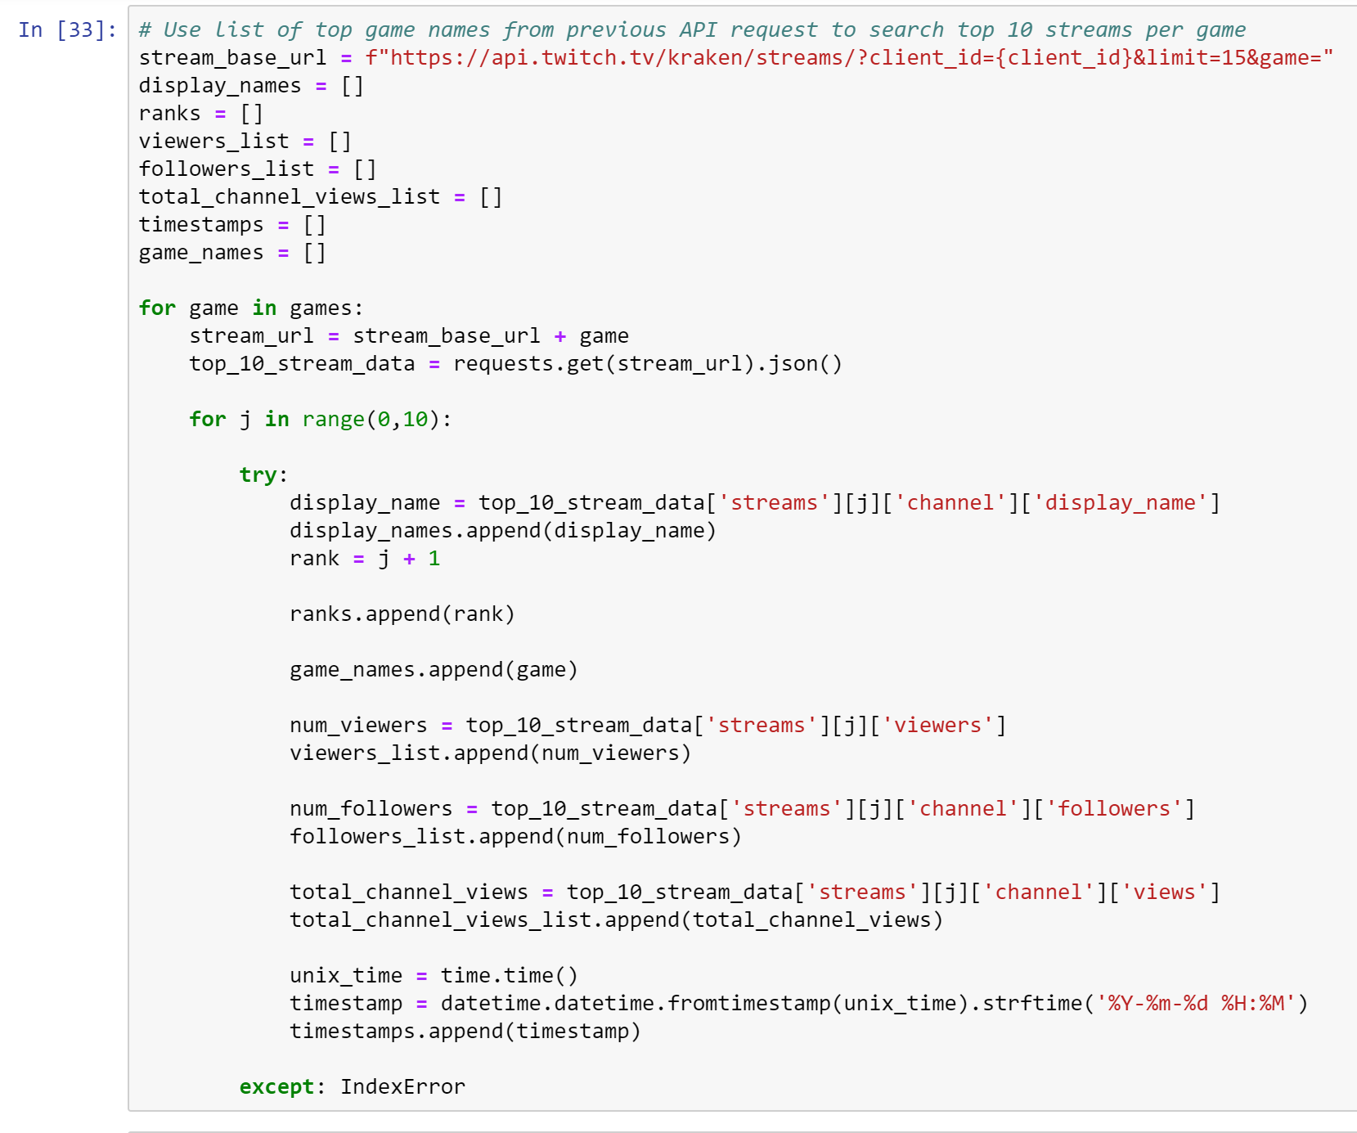
\ Structurize/ Manipulate Data via Pandas
Structurize Data via Pandas
Notes:
Using pandas, we put all the data that was extracted from the API into data frames to visualize, observe and look for trends

Slide 10
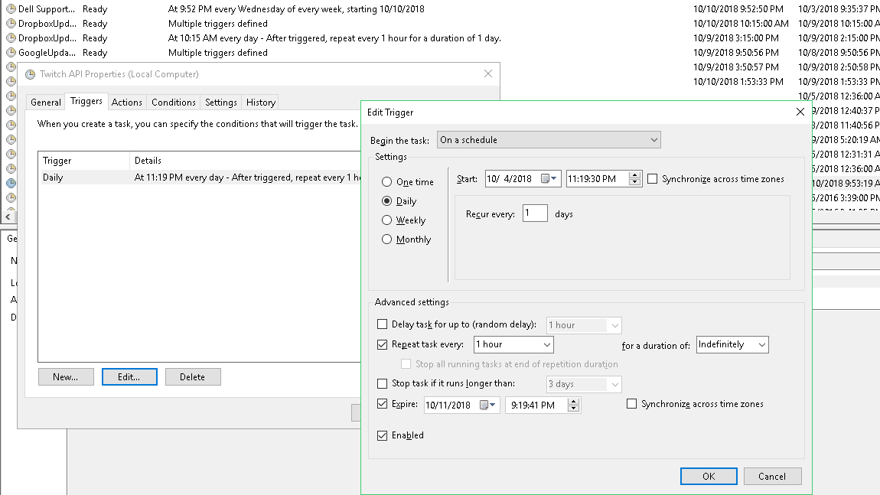
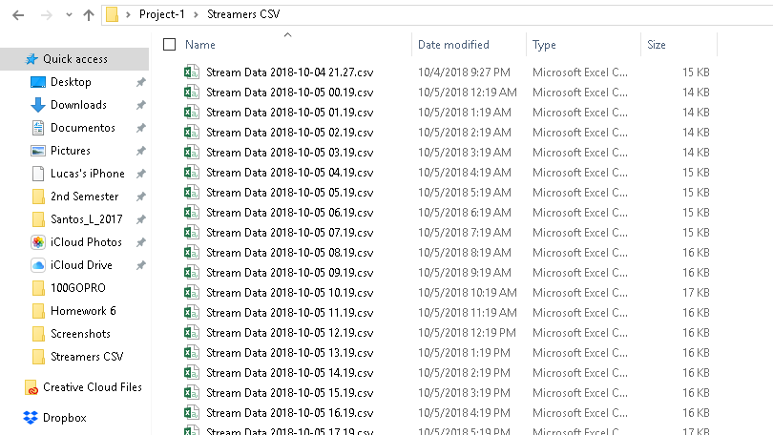
\ Export to CSV Hourly & Merge
Export to CSV Hourly & Merge
time_stamp = time.strftime("%Y-%m-%d %H.%M")
file_path= f"Streamers CSV/ Stream Data {time_stamp}.csv"
stream_df.to_csv(file_path, index = False, header = True, sep = ',', encoding = 'utf-8')
Notes:
We utilized the windows program task scheduler to run our python code that created a CSV file hourly.

Slide 11
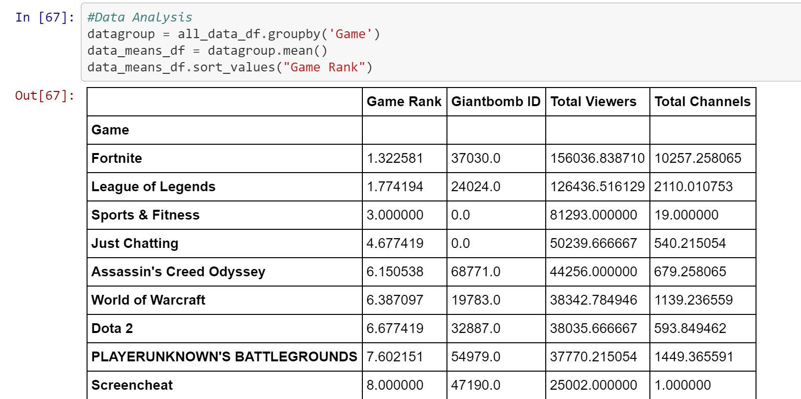

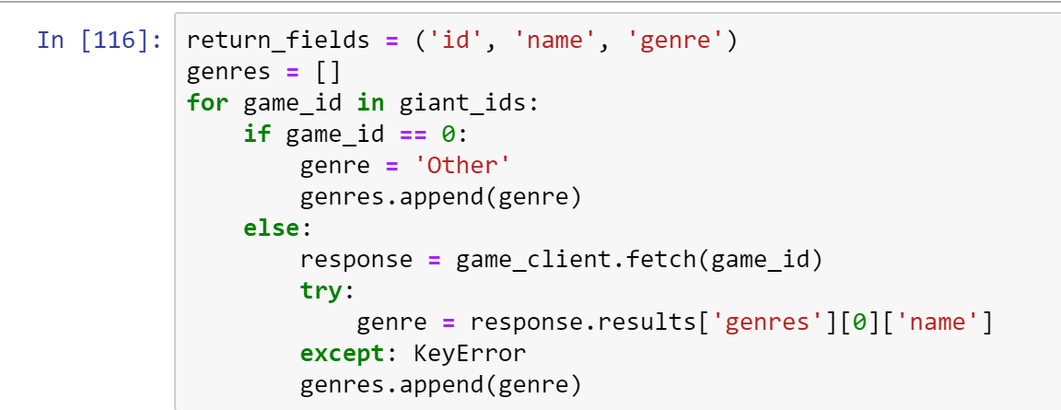
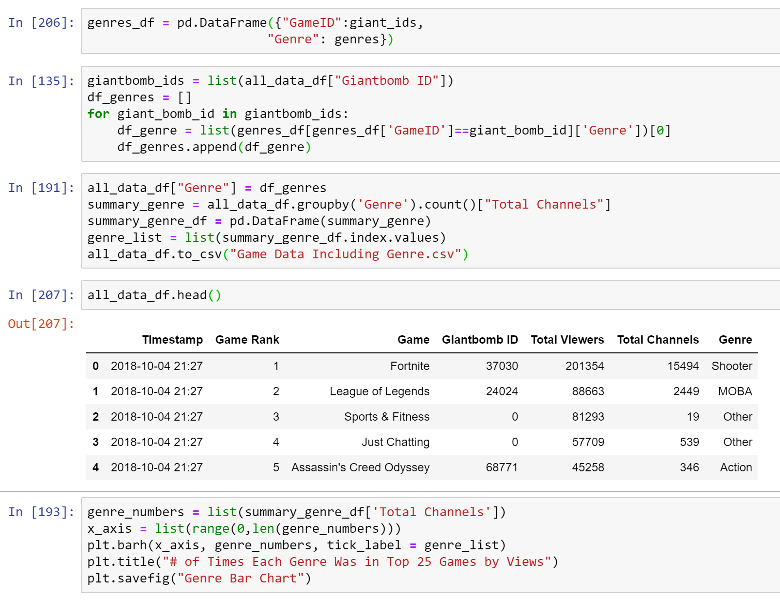

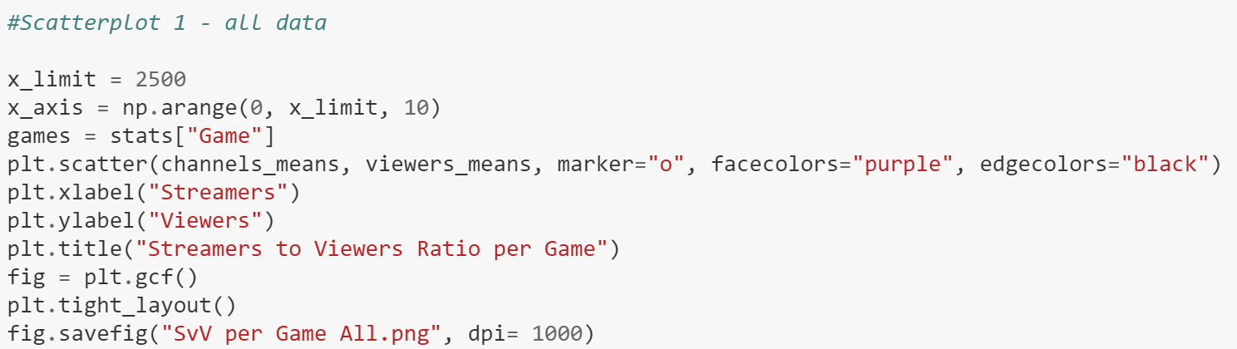
\ Sense Making
Notes:
We gathered as a group and made sense of our research

Slide 12
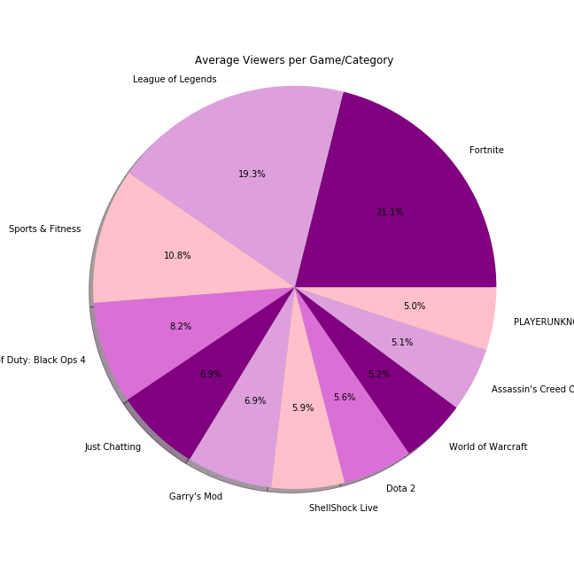
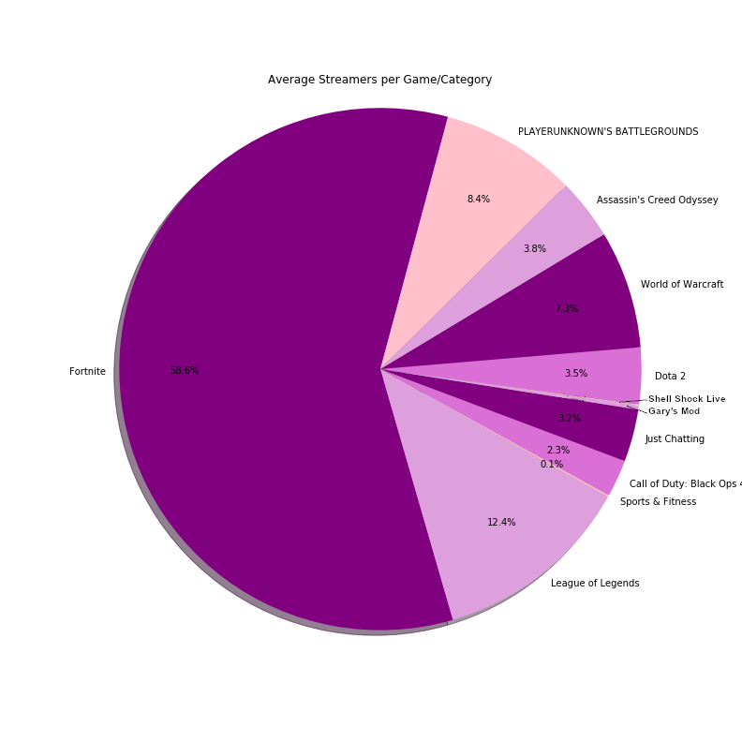
We Found that...
Notes:
Here is a breakdown of what we saw during the week for the average viewers and streamers for the top 10 games.
As you can see, Fornite has a big chunk of the audience but also a huge surplus of streamers for the hours
There are a few good assumptions we can make of this chart.
As a game developer or new streamer, it would be interesting to see what platform has a large audience but amount of streamers to find not only demand for that game or category, but also where competition for viewership is less intimidating
Sports & Fitness ~11% of viewership , only 0.1% of streamers

Slide 13
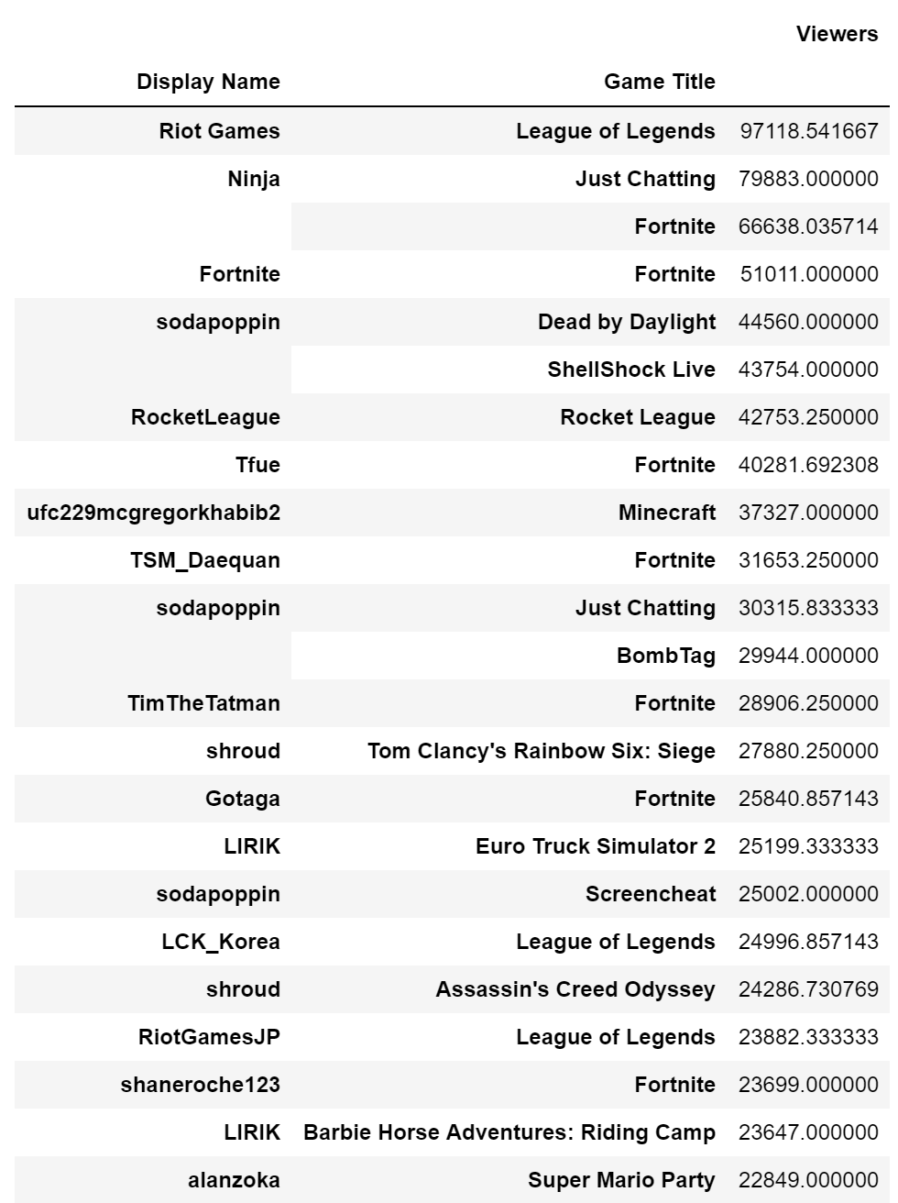
\ Cumulative Average Views per Streamer
Notes:
What this table is showing is that the number of cumulative average viewers that they have during the 7 day time ..
Developers & companies who have their own channels are doing well and are matching the streamers
If you are trying to get in the industry, an observation is that you could try to create your own channel on Twitch to gain exposure.
Some of the top games being watched on twitch chave official channels that do as well or even better than the top individual streamers for that game. Great for audience interaction and marketing game for little cost.

Slide 14
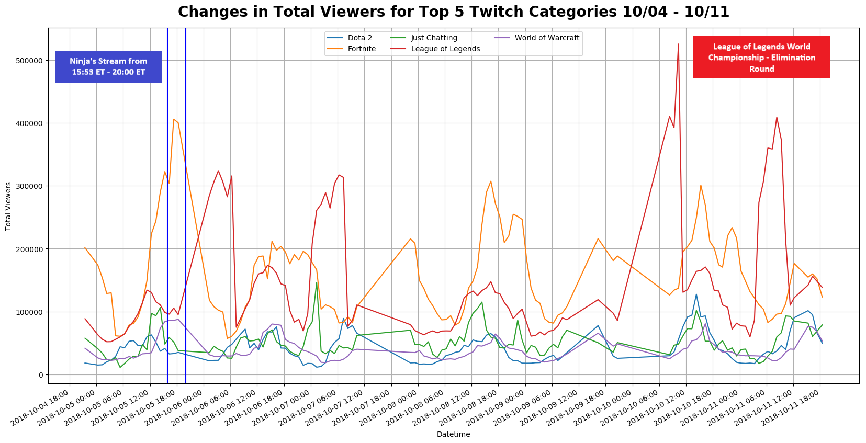
\ Viewers Over Time
twitchmetrics.net
Notes:
Here is a figure showing the changes in total viewers for the top 5 viewed categories over the week.
Interesting tidbits - When Ninja starts his stream, viewership in Fortnite peaks. League of Legends WC shows highest peak in views for LoL
Trends -
Viewership in US games tends to peak at the same time, indicating the optimal time for a new developer to time starting their stream or for when a new streamer to have the best possibility to attract the largest audience.

Slide 15
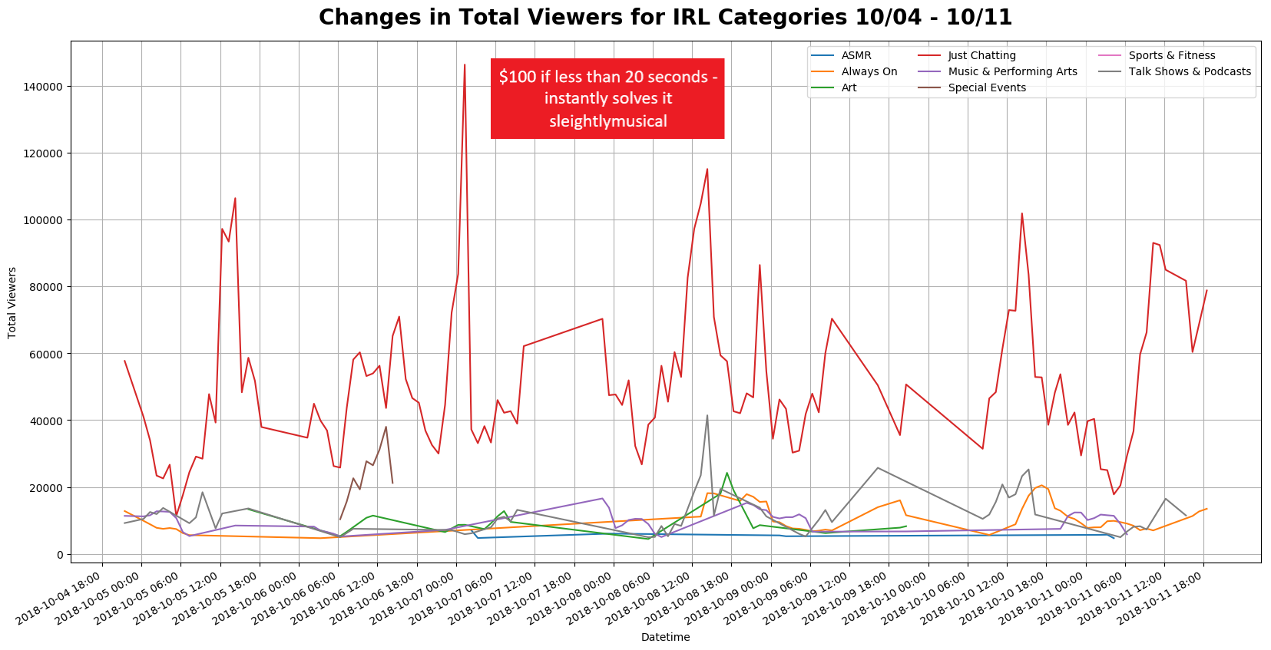
\ IRL Viewers Over Time
Notes:
Here is a graph of changes in viewers for just streams with in the In-real-Life or IRL categories. These include channels like just chatting, Arts & Performance, and Art. This would be great to show to potential content creators that there is a huge audience for entertainment other than video games on Twitch. It also shows the flexibility of Twitch in that it can accommodate a wide array of entertainment options.

Slide 16
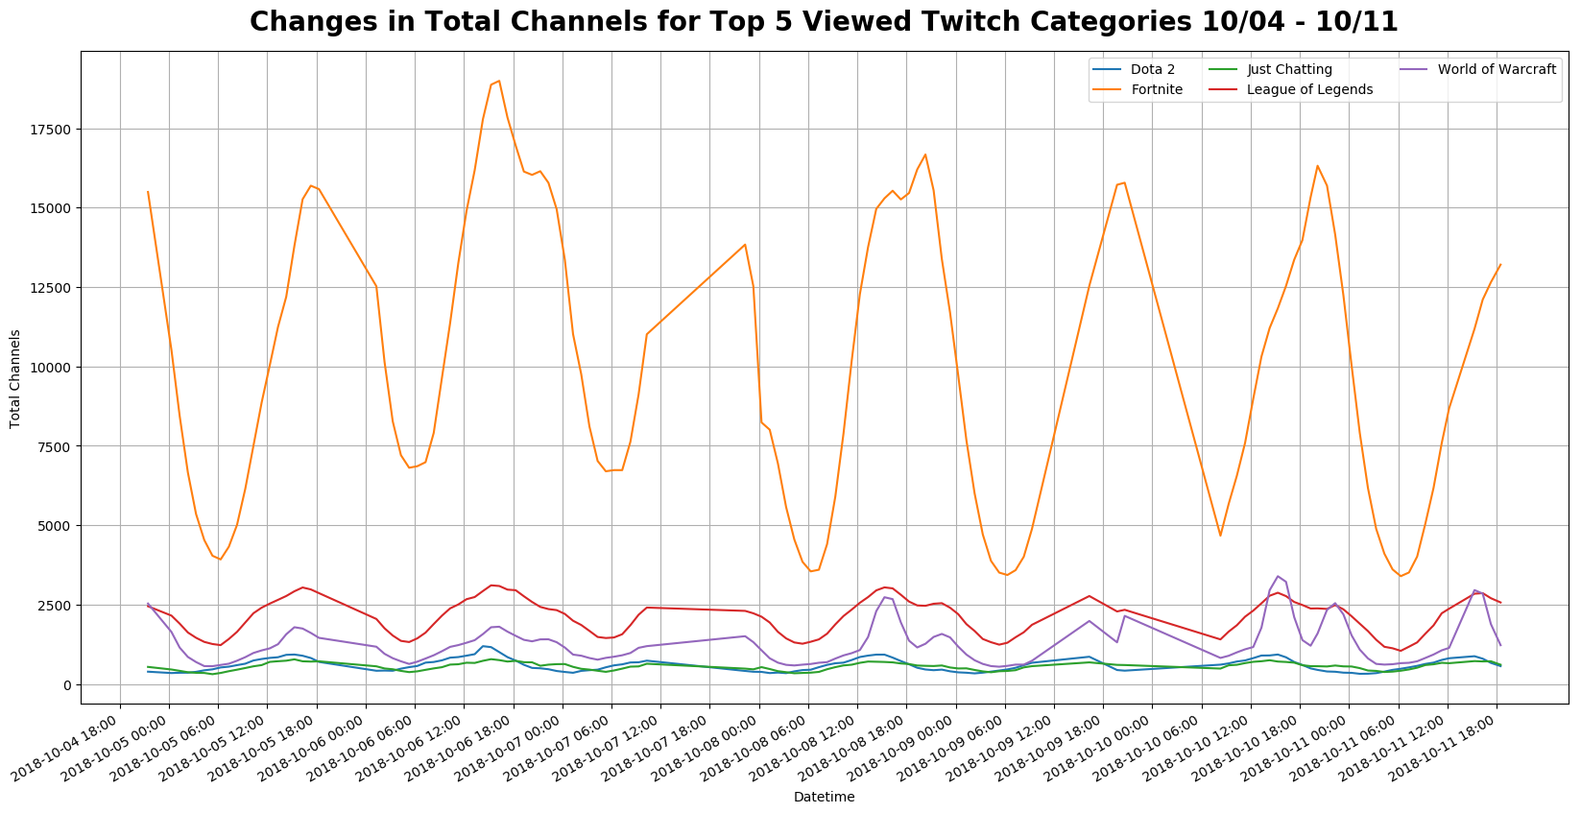
\ Channels Over Time
Notes:
We were also interested in seeing how the number of channels for the top 5 most viewed games changed over the week. We saw a huge amount of change for fortnite channels, while the other top 4 remain rather constant. This again shows the large amount of competition for fortnite viewership, where the amount of streamers to viewers is large compared to other games. If you’re are trying to get into a popular game such as fortnite, this chart would be crucial to show you when to begin streaming, or when the number of channels is relatively low.

Slide 17
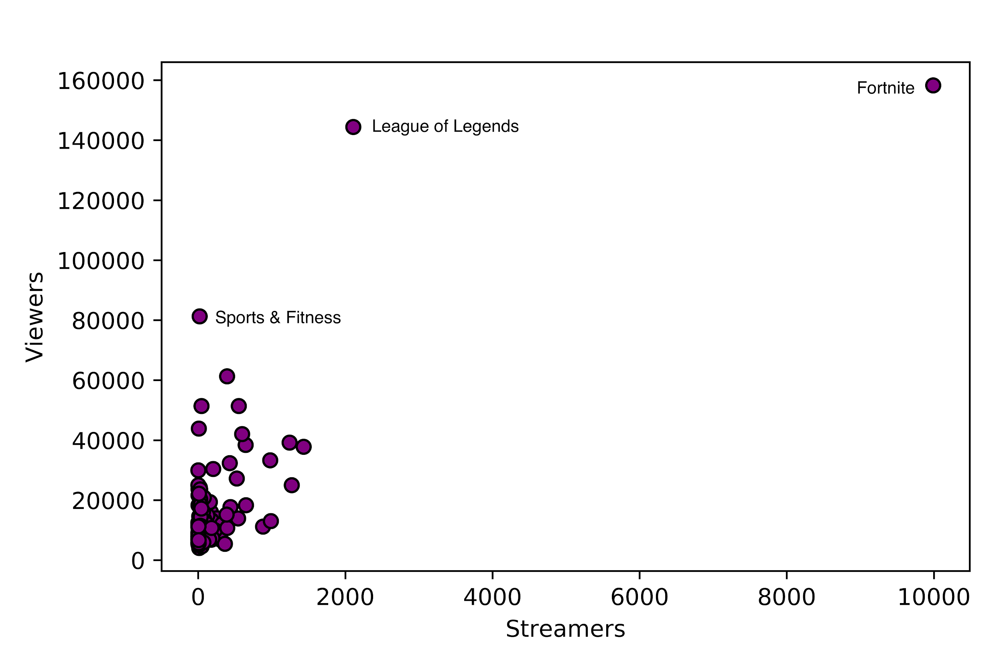
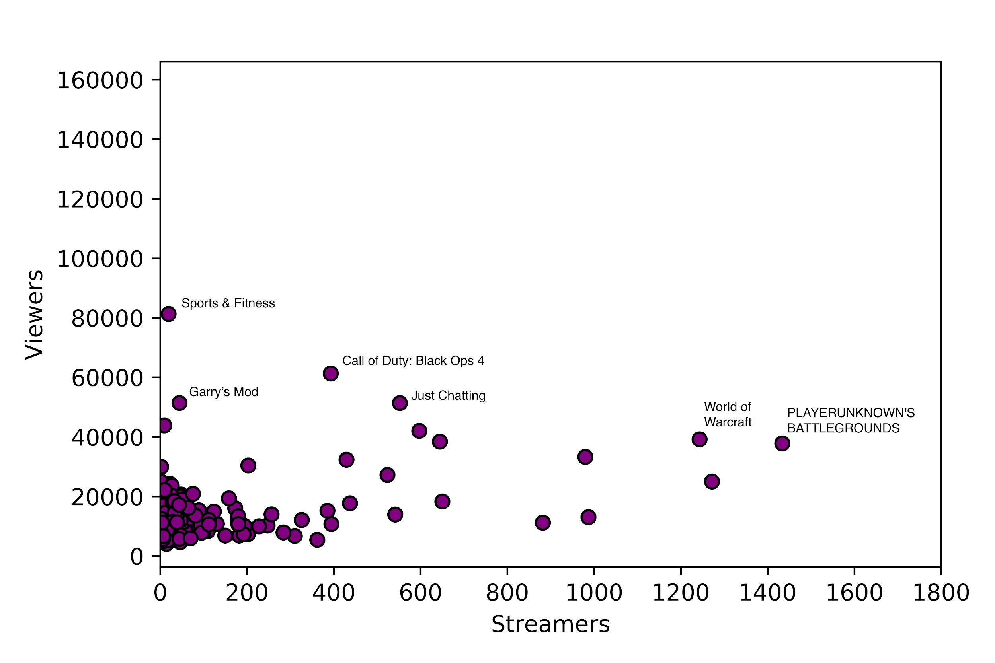
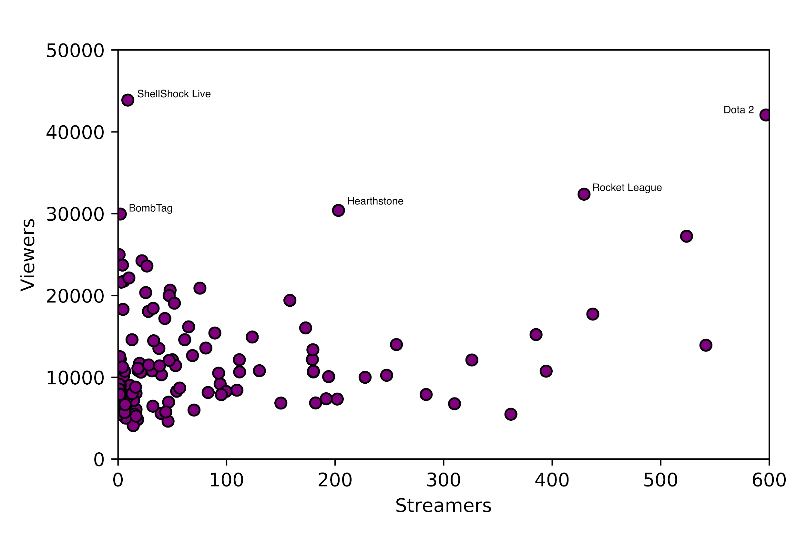
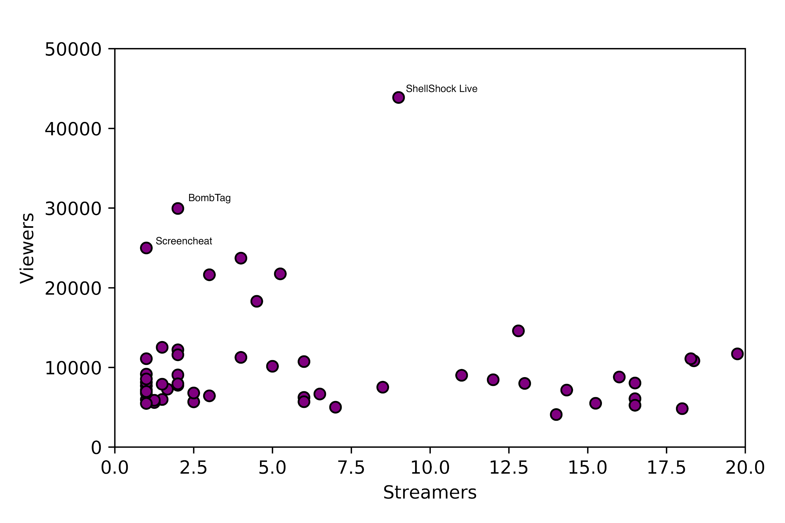
\ Streamers to Viewers Ratio per Game
Notes:
Fortnite, PLAYERUNKNOWN'S BATTLEGROUNDS, screencheat - Shooter
Call of Duty, gary’s mod - first person shooter
League, Dota2 - MOBA (mass online battle arena)
Sports and Fitness, Just Chatting - Other
World of Warcraft - MMORPG (Massively multiplayer online role-playing games)
Shellshock live, BombTag - action
Hearthstone - card game
Rocket league - racing
We also felt it was important to look at the streamers to viewers ratio per game. Looking at all the games and channels, there are clearly a few games that stand out. Fortnite, League of Legends, and Sports and Fitness are consistently at the top and have relatively even ratio of streamers to viewers. Comparatively, a majority of games are clumped together and have a smaller ratio, with less than 2000 streamers to 60000 viewers. But how is this useful? Well for a new twitch streamer, this could help them decide which game they want to stream for. Games that have a high streamer count, such as Fortnite, League, and World of Warcraft, could provide a supportive community feel for an up and coming streamer, where they can look at other streamers to determine how best to format their channel and the best or most interesting content. Of course, a drawback to streaming for these games would be that they would also be competing with a large number of streamers to gain viewers. So games that have a higher viewer count to streamers, such as Dota 2, ShellShock Live, and BombTag, could provide new streamers with less competition, and the opportunity to carve out a niche and a space for themselves. BombTag for example currently has only 2 viewers, while its total average viewer count is around 30000. So if a third streamer came in and started streaming some interesting or different, there could potentially be a higher chance for this third streamer to gain a large amount of viewers.

Slide 18
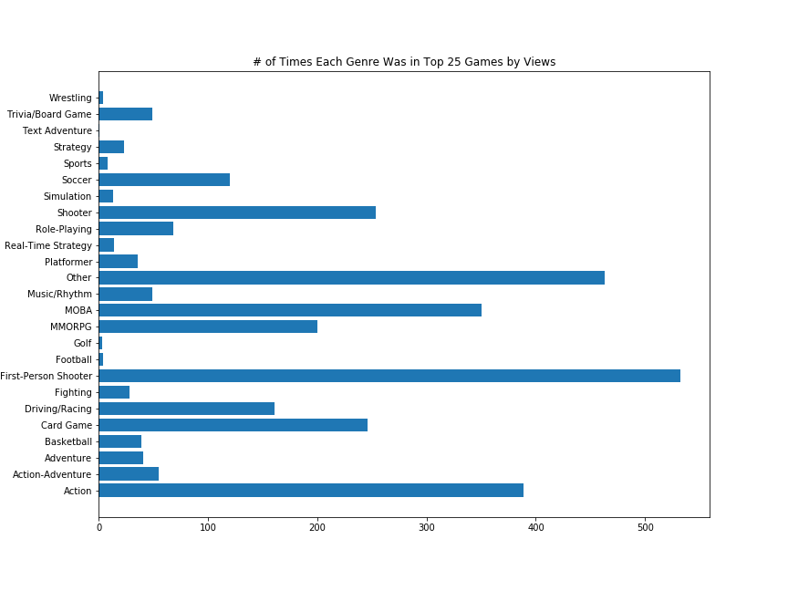
\ # Times each genre was in Top 25 Games by Views
Notes:
Genres of the games are equally important. Clearly, first person shooters are the most popular type of game watched on Twitch. But it’s interesting to note that Other comes in a close second. The other category comprises of anything that does not fit into a game category. Sports and Fitness and Just Chatting are two examples that have a large amount of viewers. So as a new twitch streamer, this could help them determine which genre would provide a greater chance of obtaining viewers. As a game developer, this data could help determine what genre of game they should focus on. They could then develop games that have a high probability of becoming popular, and could cater to a certain audience. They could also steer into taking advantage of this Other category. Just as an example, With sports and Fitness, where viewers watch streamers work out, game developers could create an interactive module that creates these workouts into games. So theres a lot that can be done here by focusing on genres.

Slide 19

\ Limitations and Conclusion
Notes:
So whats the overall takeaway here? we obviously had a few limitations as we mentioned earlier. If we had historical data, financial data, or demographics, we would have been able extend and broaden our analysis in a way that would perhaps be even more beneficial to game developers and streamers. However, despite our limitations, we were still able to extract useful in depth analysis about streamers, the audience, and the games. Individual streamers, as well, can determine what game to stream for, what type of content to create, and when to stream. Game developers can still use our analysis to determine which games to create, what genre and audience to market to and which streamers they could potentially partner with to increase their viewer base. Just as importantly, our data highlights the importance and popularity of Twitch. Twitch is clearly more than just a video gaming streaming platform, and has expanding to include a supportive community with chatting, non gaming content, and opportunities for game developers to directly interact with its audience and cater to its market. So with Twitch there’s a lot of opportunities for growth and room to change the way we interact with each other and with developers online.

Slide 20
\ Questions?

